Slide 1

SKY WIFI & IPv6
Simone Carturan
(Network Architect)
simone.carturan@skytv.it

Slide 2
Agenda
Sky Wifi & IPv6
Sky Wifi Network:
  Sky Broadband Network
Network Architecture:
  Optical Transmission
  IP Core
  Accesso FTTH/C
Services:
  SKY Content Service Provider and Internet Service Provider (OTT, CDN, Peering)
  Broadband & IPv6
    MAP-T
      MAP-T in Sky
      Sky IPv6 Experience

Slide 3
Sky Wifi
Metro Aggregator switch
x8 P Core routers
OLTs
+ NNIs
x14 Transport Aggregator POPs
x8 Peering & Transit routers
˜60% CB on FTTC
˜40% CB on FTTH
Edge POP
National POP
Super POP
Access
carriers
Satellite POP
Internet
Sky WiFi
customers
Access Network
Metro Network
Core Network
Peering

Slide 4
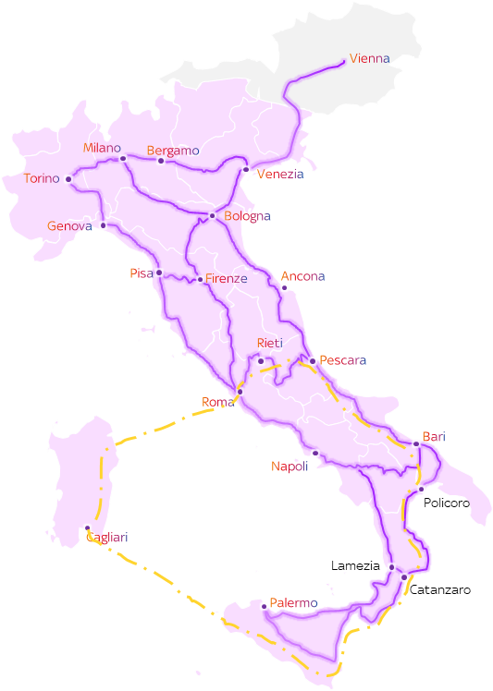
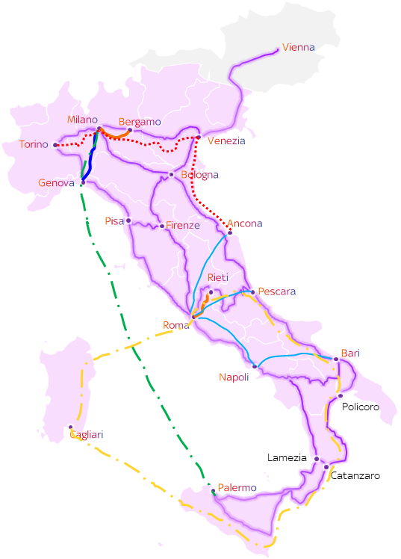
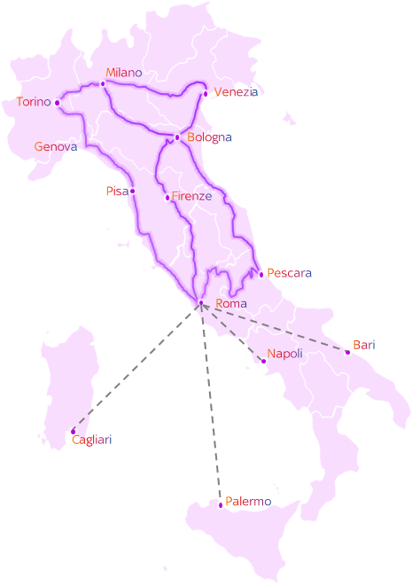
Sky Wifi – Optical Transmission
Optical Transmission Map
2020
2022
2024
8500 Km Dark Fiber
(IRU & Leased from Wholesale partners)
x40 Multi-degree ROADM
Extended C-Band Spectrum (4,8 THz)
47 Tb Optical capacity deployed
Optical Restoration
Consolidated routes
2024
2025
Leased lines*
Consolidated routes
2025 Under Evaluation
Leased Line
Leased Line

Slide 5
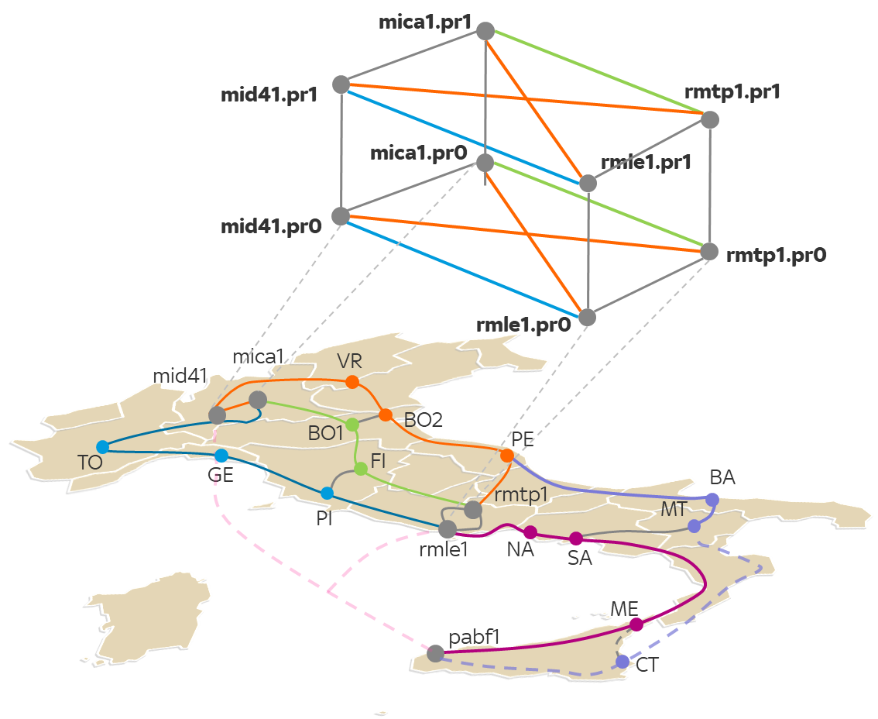
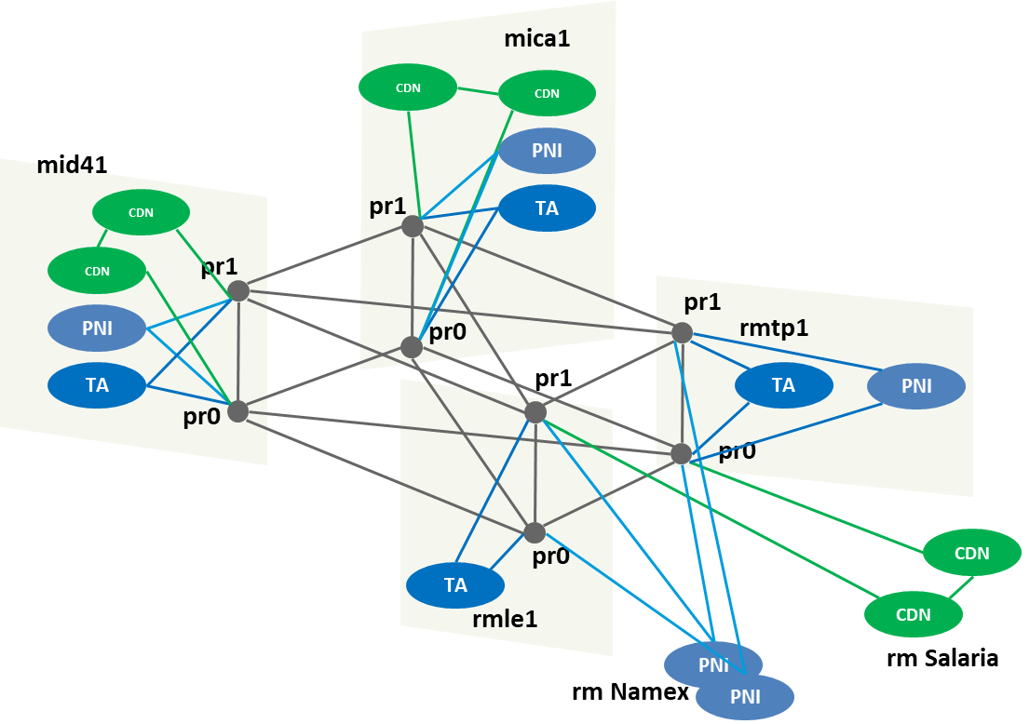
Sky Wifi – IP Core
IP Core
PRs
IGP: ISIS
No BGP
No LDP
SR + MPLS
The Sky WiFi Network Supercore is a full mesh topology between the Milan and Rome Super POPs comprising dual Plane of MPLS PRs (Provider Routers).
Sky WiFi IP Network supports both IPv4 and IPv6 for all platforms and services.

Slide 6
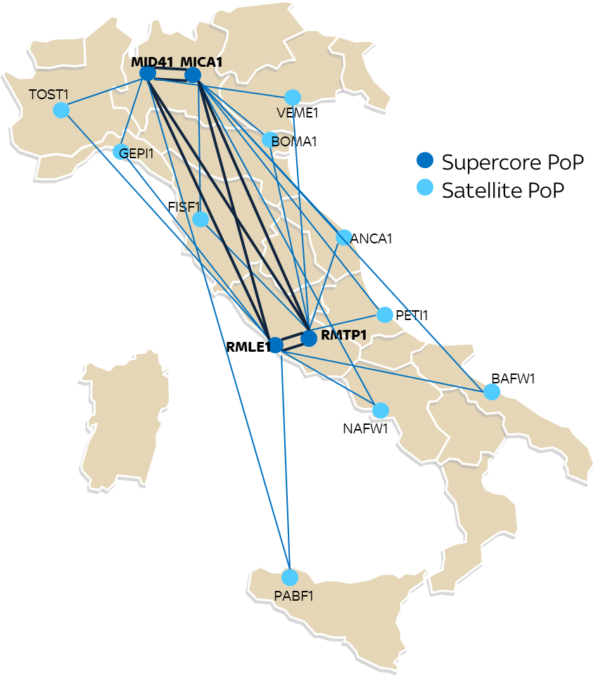
Sky Wifi – IP Core
Satellite POPs
PEs Routing Protocols
IGP: ISIS
BGP
SR + MPLS
6PE
Dual HUB Network
Each Satellite POPs is directly connected both Milan and Rome

Slide 7
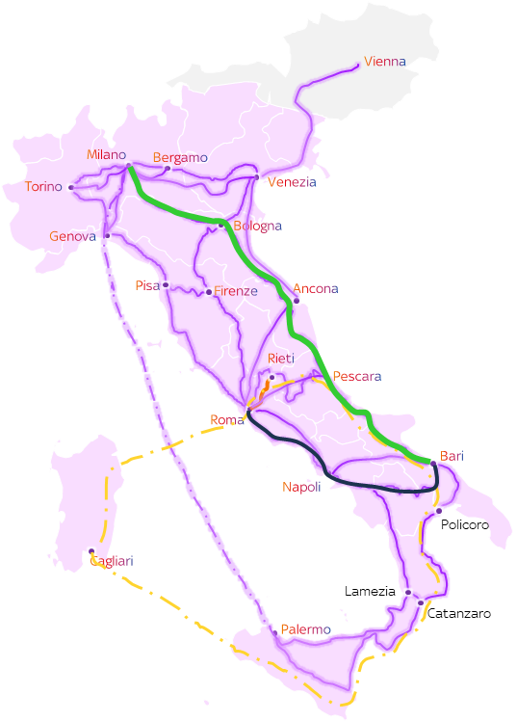

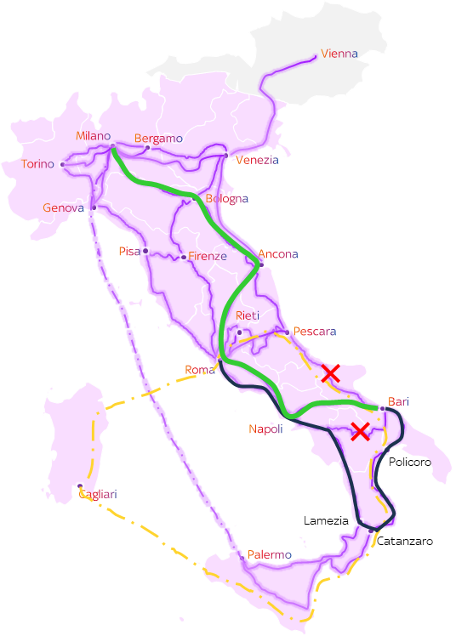
Sky Wifi – IP + Optical
TI-LFA + Optical Restoration
8500 Km of Dark Fiber: multiple fiber cuts and site isolation are not negligible.
TI-LFA < 50 ms Optical Restoration ˜10 min MTTR < 15 min
2 IP Core redundant links + multi Optical Paths (at least 3 or more)

Slide 8
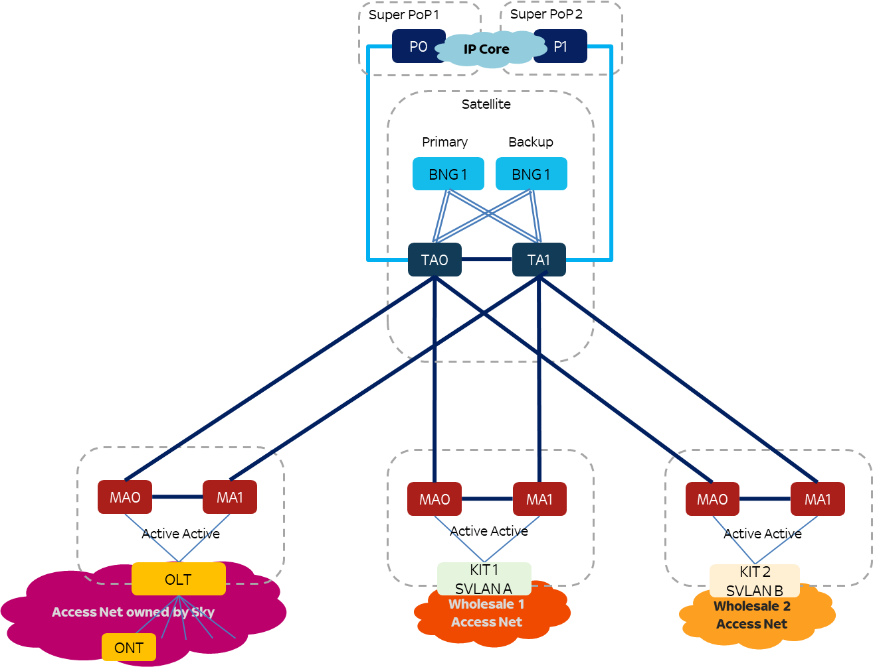
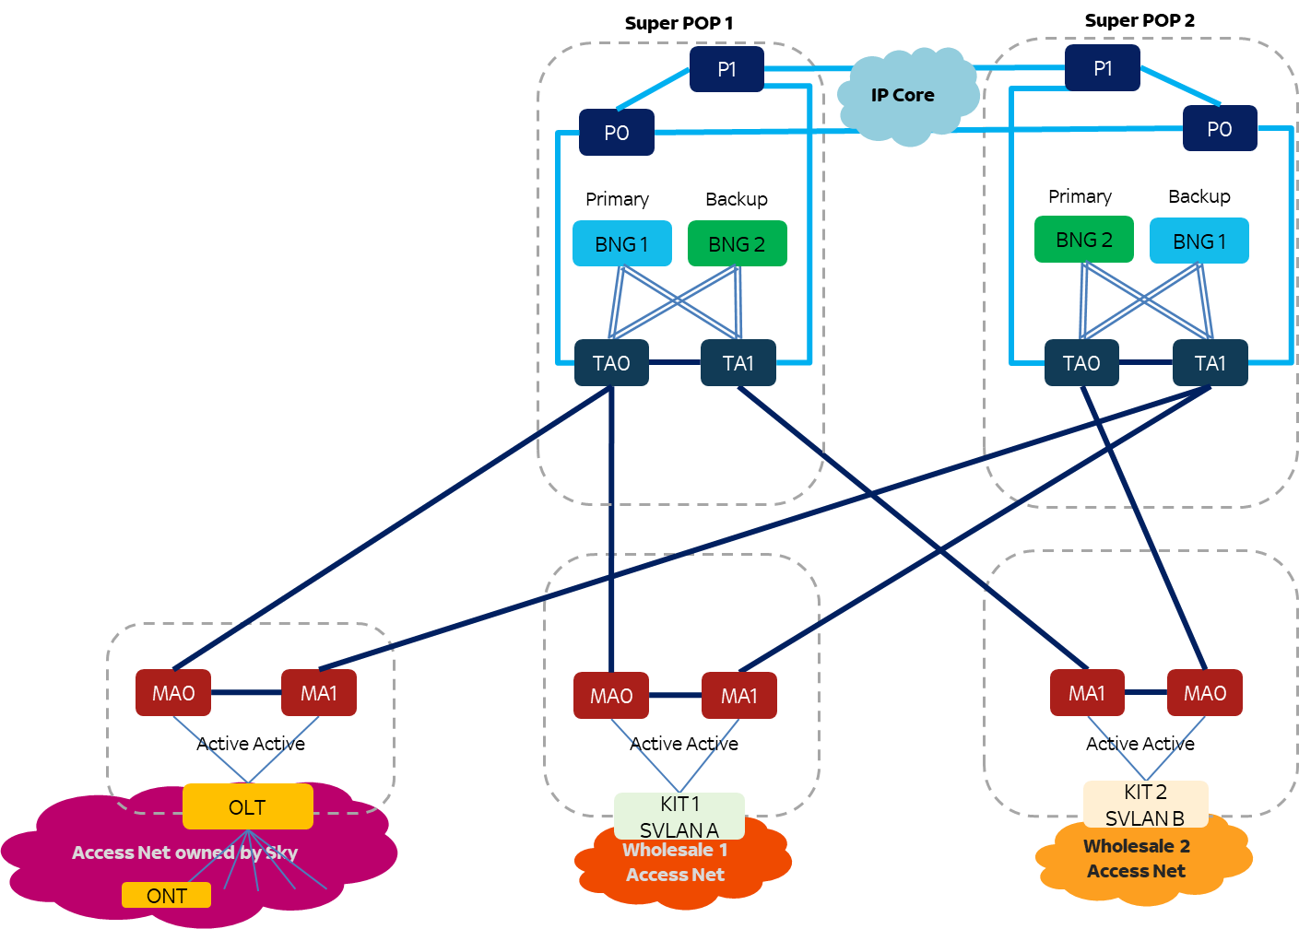
Sky WiFi - FTTH / FTTC Access Network
Satellite POPs
Super POPs
FTTH
FTTH
FTTC/H
FTTH
FTTH
FTTC/H
Wholesale partners
Wholesale partners
Control Plane EVPN + Data Plane MPLS. It’s a multihoming single active EVPN VPWS architecture. Each MA forward traffic to the active BNG via the active VPWS. A backup VPWS towards second BNG will ensure redundancy.

Slide 9





















Sky Ecosystem
      VIDEO SERVICES INTERNET SERVICES
TIER 1
OTTs
TRANSIT PROVIDERS
Global CDNs
Private CDNs
CDNs
PNIs
Cache 3rd Party
Transit
PNIs
ISPs
Inbound / Outbound traffic ratio: 55% / 45 %

Slide 10
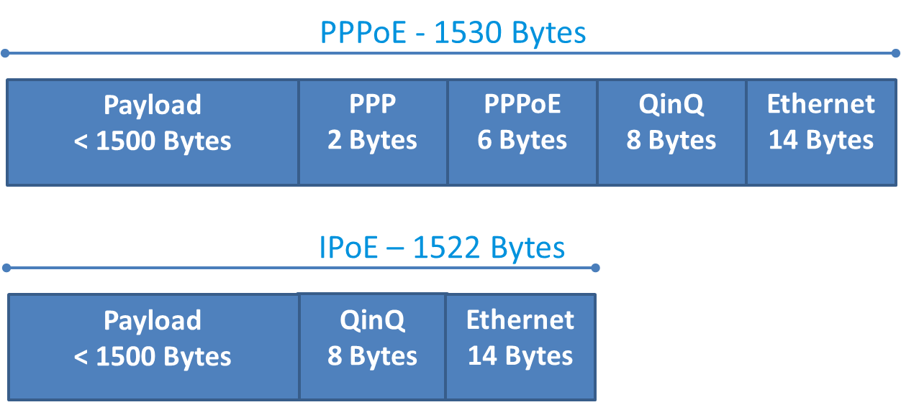
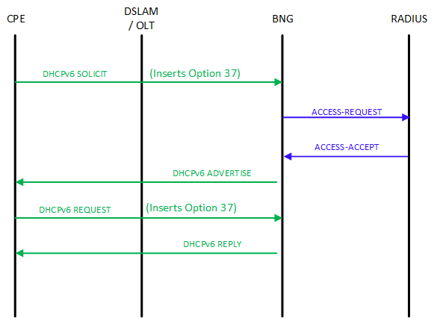
Sky WiFi IPv6 Experience
IPoE Authentication
Green-field network
GPON and VDSL2, support native Ethernet framing.
Overhead efficiency compared with PPPoE (+8bytes)
No need for tunneling and encapsulation protocols
Uses DHCPv6 Option 37: Remote-ID (Port Based Authentication)
No use CHAP-style <username@domain> + <password> for authentication

Slide 11
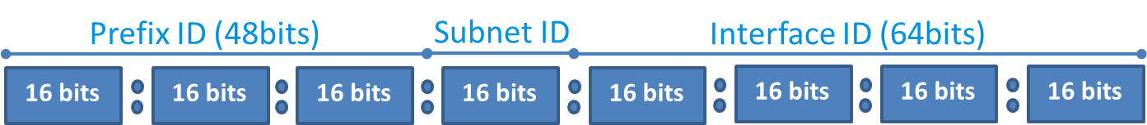
Sky WiFi IPv6 Experience
How are we using it?
Sky Italia, few years ago, has purchased a /13 (524,288 IPv4 addresses) from the open market, and assigned a /25 IPv6 address space by RIR.
Each Sky Hub obtains is assigned a Prefix Delegation of size /48 by using stateful DHCPv6 PD.
(Recommended by RIPE-690 BCOP)
An IPv6 prefix of /48 contains 65,535 x /64 prefixes. 2^(64-48)
The Sky Hub currently only uses a single /64 for the LAN (incl. wifi).
Remaining prefixes are available for future use. (IoT, Guest Wifi, etc.)
LAN-side devices acquire IPv6 addressing by using Stateless Address Auto-Configuration (SLAAC).
The Sky Hub doesn’t assign IPv6 addresses, it simply advertises the /64 prefix on the LAN and the client devices choose their own address.

Slide 12
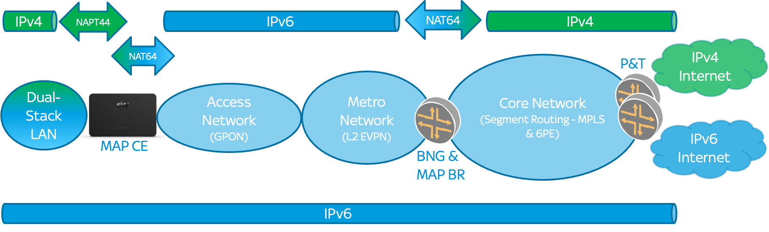
MAP-T
Definition
Mapping of Address + Port (MAP) is a stateless IPv4-as-a-Service (IPv4aaS) technology, delivering IPv4 connectivity via IPv6 infrastructure.
The biggest drawcard for MAP is that it is stateless; it means that devices doing the NAT64 translation, do not have to track of every flow that they're forwarding.
MAP achieves this statelessness by using predefined translation algorithms, or rules, communicated to the MAP devices.
3 distinct points of translation
  Stateful NAPT44 on the Sky Hub (”Regular NAT”)
  Stateless NAT46 on the Sky Hub
  Stateless NAT64 on the MAP Border Relay (embedded on BNG)

Slide 13
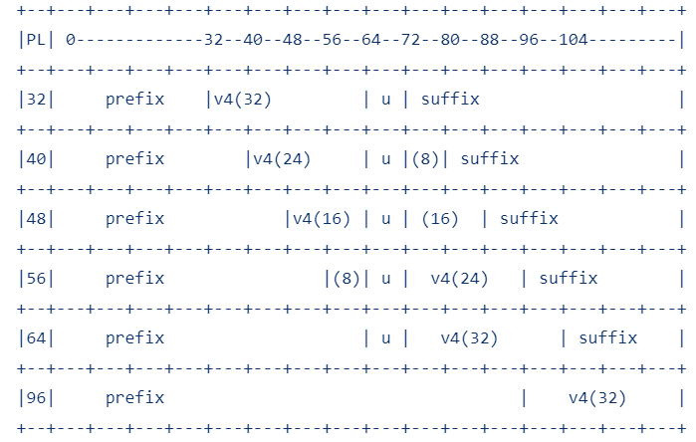
MAP-T Mapping Rules
Default Mapping Rule (DMR)
The DMR is a mandatory rule and tells the MAP CE what IPv6 prefix to use when translating an IPv4 destination address outside of the MAP domain, to an IPv6 address. (and vice versa).addresses. (RFC6052)
(RFC6052) IPv4-embedded IPv6 addresses used for external host destination address.
Sky uses /64-sized DMR prefixes

Slide 14
MAP-T Mapping Rules
Basic Mapping Rule (BMR)
The BMR is the main MAP rule that tells both the MAP CE and Border Relay how to do the stateless NAT64 translation. It also informs the MAP CEs which layer 4 ports they're allowed to use.
Each subscriber is assigned a Prefix Delegation of size /48. The Sky HUB currently uses a single /64 for the LAN.
Mapping rules are communicated to the CPE via DHCPv6 option 95 within the lease (RFC7598)
Combination of DHCPv6 PD + Option 95 define the IPv4 address and port the CPE is allowed to use.
Sky uses 1:16 Ratio
/48
2a0e:418:ff00:00/32
EA Bits
(16 = 12 + 4)
Subnet
(16)
Interface ID (64)
101.56.120.0 / 20
Suffix
(12)
:
6
PSID
(4)
6
4096 IPv4 addresses, 65536 users, 4032 ports each.

Slide 15
MAP-T IPv4 Packet translation Example
1
3
2
192.168.0.0/20
2001:dB8:c:2::/64
TCP/UDP Header |  | IPv4 Header (20 Bytes)
SPORT: 6783 | DPORT: 80 | SOURCE: 192.168.0.123 | DEST: 8.8.8.8
1
Stateful NAPT44 translates both source port and source address
TCP/UDP Header |  | IPv4 Header (20 Bytes)
SPORT: 1200 | DPORT: 80 | SOURCE: 151.230.60.51 | DEST: 8.8.8.8
2
MAP-T on CPE translates source address based on BMR, and destination address based on DMR and RFC6052
TCP/UDP Header |  | IPv6 Header (40 Bytes)
SPORT: 1200 | DPORT: 80 | SOURCE: 2001:db8:c:2:97:e63c:3300:0000 | DEST: 2001:db8:ffff:0:8:808:800:0000
3
MAP-T Border Relay translates source address based on BMR, and destination address based on DMR and RFC6052
TCP/UDP Header |  | IPv4 Header (20 Bytes)
SPORT: 1200 | DPORT: 80 | SOURCE: 151.230.60.51 | DEST: 8.8.8.8

Slide 16
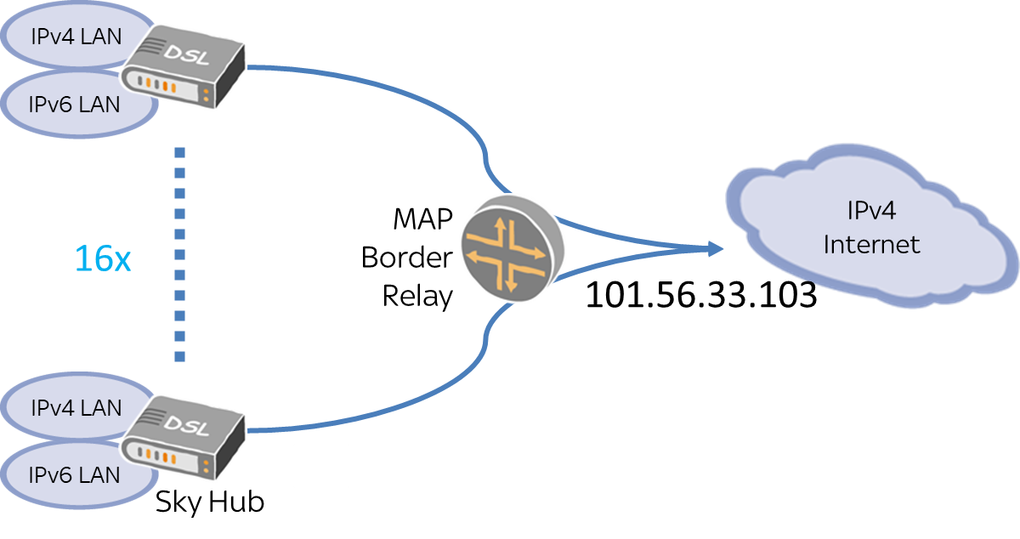
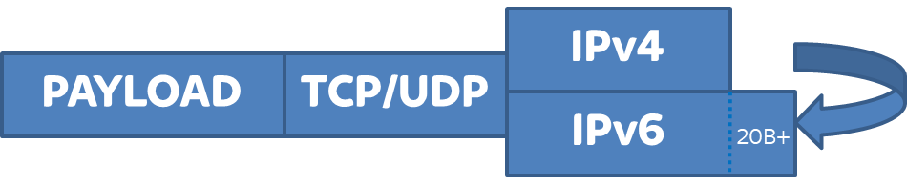
Sky WiFi IPv6 Experience
Why MAP-T
Sky Wifi was born as a Greenfield Network
IPv6-only Access Layer
Stateless
MAP Border Relays (BR) do not have to keep track and state of every flow
RFC7597: MAP-E (Encapsulation)
Larger per-packet overhead.
IPv4 header remains intact.
IPv4 sharing
Sky WiFi uses 1:16 IPv4 ratio sharing
Efficiency
RFC7599: MAP-T (Translation)
Less per-packet overhead (not zero!)
Loses IPv4-only header attributes.

Slide 17
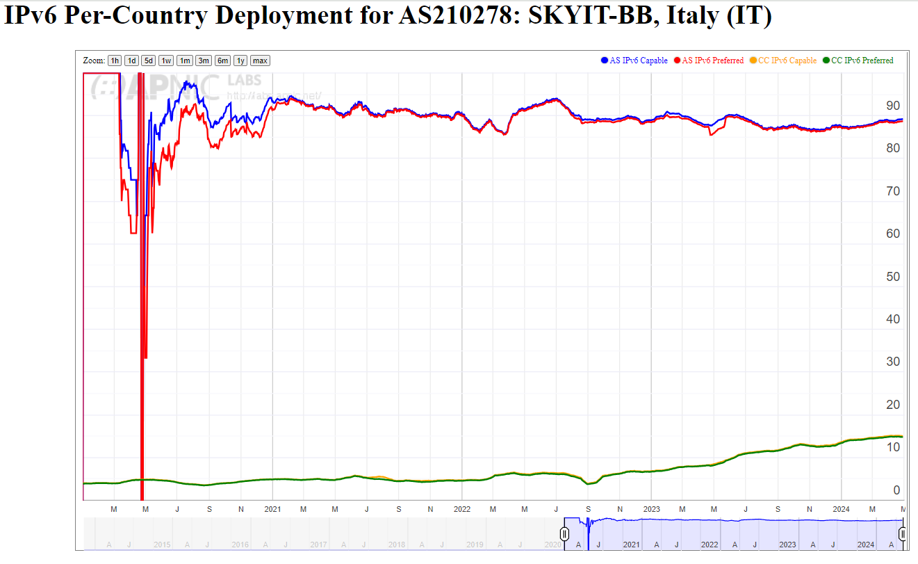
Sky WiFi IPv4 vs IPv6
ASN | AS Name | IPv6 Capable | IPv6 Preferred | Users (est.)
AS1267 | WINDTRE | 30.90% | 30.36% | 8.263.884
AS30722 | VODAFONE ITALIA | 4.42% | 4.35% | 7.880.751
AS3269 | TIM | 0,17% | 0,03% | 6.655.848
AS29447 | ILIAD ITALIA | 10.03% | 9.97% | 3.794.954
AS12874 | FASTWEB | 40.79% | 40.35% | 3.472.978
AS210278 | SKY ITALIA | 89.24% | 88.74% | 978.451
AS8612 | TISCALI | 0.09% | 0.03% | 688.789
AS35612 | NGI | 0.19% | 0.03% | 750.729
AS198471 | LINKEM | 0.14% | 0.04% | 418.958
Source: APNIC – IPv6 deployment

Slide 18
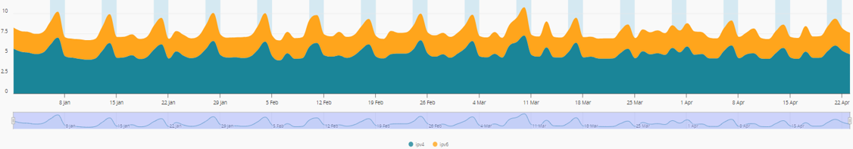
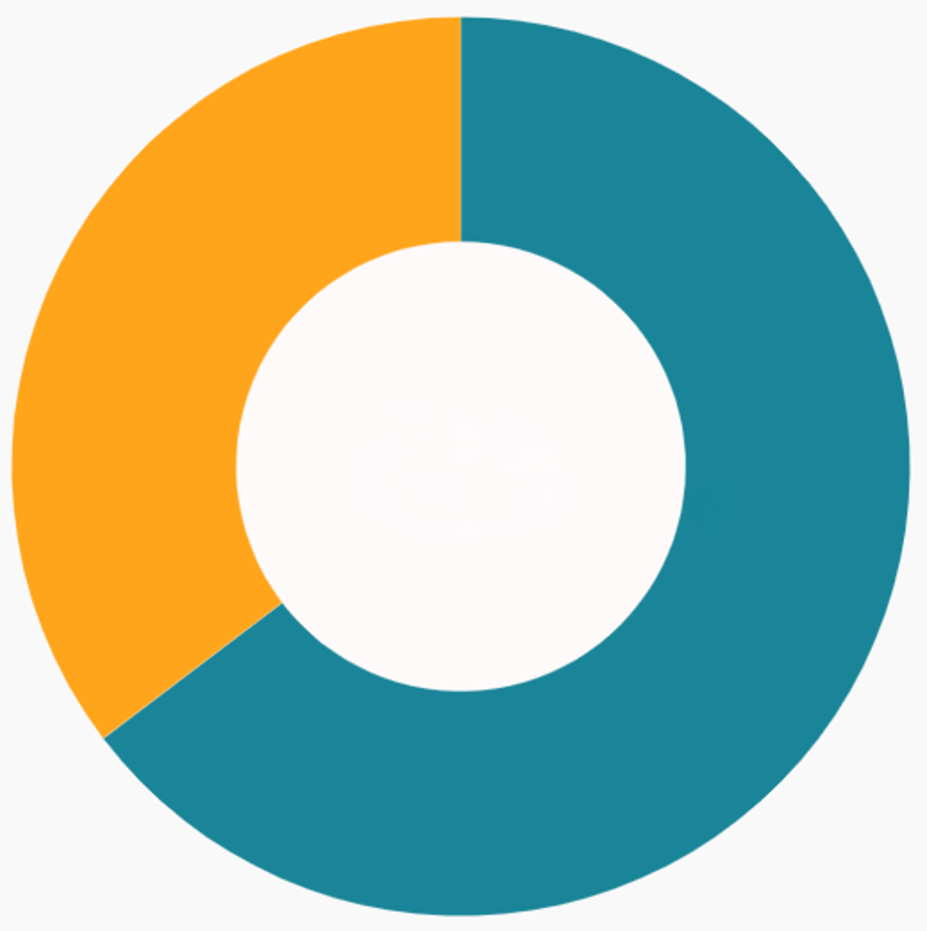
Sky WiFi IPv4 vs IPv6
YtD Volumes
YtD
IPv6
By providing IPv6 to all customers we are seeing the following usage of IPv6:
IPv6: 35% ( ˜3% vs 2023) IPv4: 65%
2) Despite all of subscribers are IPv6-only,
there is still a good portion of volumes in IPv4.
IPv4

Slide 19






Sky WiFi IPv4 vs IPv6
CDN
GAMING
SOCIAL
STREAMING

Slide 20

THANK YOU
Simone Carturan
(Network Architect)
simone.carturan@skytv.it

